Slide 1

Using the Index of Multiple Deprivation (IMD) to understand the drivers of deprivation in your district
Presentation to Waikato Strategic Planners Network
Rachael McMillan – Waikato Plan Programme Manager and Associate Professor Daniel Exeter
Friday 9 March 2018
Notes:
I will be presenting on a report I have been writing for the Waikato Plan to share with all councils as well as giving you a taste of the index of multiple deprivation and what you can do with it. Here today we also have the researcher from the University of Auckland who developed the Index of Multiple Deprivation with his team, Associate Professor Daniel Exeter. Daniel will talk at the end of the presentation about further applications of use to the IMD and will be able to provide answers to any technical questions you may have as we go.

Slide 2

Purpose
Understanding drivers of deprivation is important for:
  Helping the Waikato Plan to determine our action priorities and areas to target
  Promoting more effective engagement between the Waikato Plan and various community agencies in the Waikato
  Helping local governments in the Waikato Region to further understand their communities to address their own unique mix of deprivation drivers
  Harnessing government funding opportunities to help address inequalities
Notes:
I will start with what the purpose of the report is…..
The report outlines:
deprivation in the Waikato Region
the Waikato’s comparative position amongst all regions in New Zealand
how deprivation has changed over time in the Region
deprivation across each district within the Waikato
the underlying drivers of deprivation in each district using the Index of Multiple Deprivation
This work is becoming increasingly important in light of the new governments direction.
They are working on the Living Standards Framework, putting the 4 wellbeings back into the LGA purpose, and moving into spatial planning. We need analytical tools to help us tap into the opportunities that will arise from their direction.

Slide 3
Background
Comparison of deprivation indices:
The New Zealand Deprivation Index (NZ Dep):
  Official statistics – Census
  9 indicators in 8 domains
  Data set from 1991 to 2013 currently
  Good for showing broad changes over time, comparison between regions
Index of Multiple Deprivation:
  Released in 2017
  Snapshot of 2013
  Not official statistics - uses IDI – integrated data infrastructure – routinely collected data from govt and census
  28 indicators in 7 domains
  Good for drilling down into the drivers of deprivation at small level
Notes:
Most people in the room will be very familiar with the NZ Dep but won’t have come across the Index of Multiple Deprivation. They provide different pictures of deprivation. The official one can help us see how deprivation has changed over time and allows us to compare easily between regions.
The IMD allows us to drill down further into the drivers of deprivation at small area level. Because there are so many indicators and some don’t register on the NZDep index we see a different picture of deprivation as these small area levels.
Both indices are relative deprivation – Therefore 10% of areas will always fall into the most deprived across the whole of New Zealand irrespective of the overall wealth of the country.

Slide 4
Domain of deprivation | NZ Dep indicators | IMD Description of variable (in order of decreasing weight in the index)
Employment | People aged 18-64 unemployed | No. of working age people receiving the Unemployment Benefit No. of working age people receiving the Sickness Benefit
Income | People aged 18-64 receiving a means tested benefit People living in equivalised* households with income below an income threshold | Weekly Working for Families payments ($ per 1000 population) Weekly payments ($ per 1000 population) in the form of income related benefits
Health |  | Standardised Mortality Ratio Hospitalisations related to selected infectious diseases Hospitalisations related to selected respiratory diseases Emergency admissions to hospital People registered as having selected cancers
Education | People aged 18-64 without any qualifications | School leavers <17 years old School leavers without NCEA L2 School leavers not enrolling into tertiary studies Working age people without qualifications Youth not in Education Employment or Training
Housing | People living in equivalised* households below a bedroom occupancy threshold People not living in own home | No. of persons in households which are rented No. of persons in households which are overcrowded
Crime |  | Victimisation rates for: Homicide and Related Offences Assault Sexual Assault Abduction and Kidnapping Robbery, Extortion and Related Offences Unlawful Entry with Intent/Burglary, Break and Entre Theft and Related Offences
Access | People with no access to a car People aged <65 with no access to the Internet at home | Distance to 3 nearest: GPs or Accident and Medical Supermarkets Service stations Primary or intermediate Schools Early childhood education centres
Support | People aged <65 living in a single parent family
Notes:
Comparison of indicators

Slide 5
Notes:
The first part of the report I have written uses the New Zealand Deprivation Index to look at comparison across regions and time.
This shows how the deprivation scores have changed over the period 1991 to 2013. These are ranked from the least deprived to the most deprived based on the end point in 2013. Overall deprivation has improved over most of the regions in the country from 1991, with the exception of Gisborne. In some areas deprivation have dropped quite markedly over the period.
Figure 2 shows that that for most regions there was an increase in deprivation in 1996 and a lowering again in 2001 before a general rise to 2013 for most areas that did not reach the height of the 1991 level. This report does not attempt to identify the reasons for the changes in deprivation across this period.
The West Coast has experienced the most significant drop in overall deprivation. Gisborne has experienced the worst overall deprivation with Northland following closely. The Waikato Region ranks 11th out of the 16 regions with a NZDep overall ranking of 5.7 in 2013.

Slide 6
Most deprived districts in North Island
The most deprived districts by % of the district’s population living in the NZDep quintile 5 areas are:
  Bay of Plenty - Kawerau (89%)
  Bay of Plenty - Opotiki (66%)
  Hawkes Bay - Wairoa (64%)
  Waikato - South Waikato (51%)
  Northland - Far North (50%)
  Gisborne - Gisborne (47%)
  Manawatu-Wanganui - Horowhenua (47%)
  Manawatu-Wanganui - Ruapehu (44%)
  Auckland - Papakura (41%)
  Auckland - Wanganui (41%)
  Auckland - Manukau (40%)
  Waikato - Hauraki (40%)
Notes:
Deprivation across the South Island has improved since 1991. The North Island has a greater level of overall deprivation than the South Island and in some parts as deepened.
Two Waikato districts feature in the 12 most deprived districts in the North Island.

Slide 7
Notes:
shows the deprivation profiles of different territorial authorities, based on the New Zealand Index of Deprivation 2013. A total of 70% of the Hauraki population are living in either deprivation 4 or 5 quintiles. South Waikato and Waitomo follow with 68% of their population in NZDep 4 or 5. Thames-Coromandel and Hamilton are 59% and 51% respectively. However South Waikato has the highest percentage of people living in NZDep 5 – 51%.
http://www.ehinz.ac.nz/indicators/population-information/socioeconomic-deprivation-profile/ - data from Massey University – Environmental Health Indicators New Zealand

Slide 8
Index of Multiple Deprivation
Data zones - 5,958 neighbourhood-level data zones in New Zealand
Each IMD data zone has an average population of 712
Data zones are ranked from the least to most deprived (1 to 5958) and grouped into five quintiles
Quintile 1 (Q1) represents the least deprived 20% of data zones
Quintile 5 (Q5) represents the most deprived 20% of data zones
Notes:
The second part of my report covers an analysis of the Waikato Councils using the Index of Multiple Deprivation.

Slide 9
IMD weighting
The domains are weighted when the overall IMD is calculated:
Employment – 28%
Income – 28%
Health – 14%
Education – 14%
Housing – 9%
Crime – 9%
Access – 2%
Notes:
Each small area in a district has a different mix of each domain that makes up the overall IMD score.
We know from literature that some measures are more strongly associated with deprivation/social position than others. Employment and Income are the most direct and strongest, while Access is about the distance to the 3 closest amenities of a particular type.

Slide 10
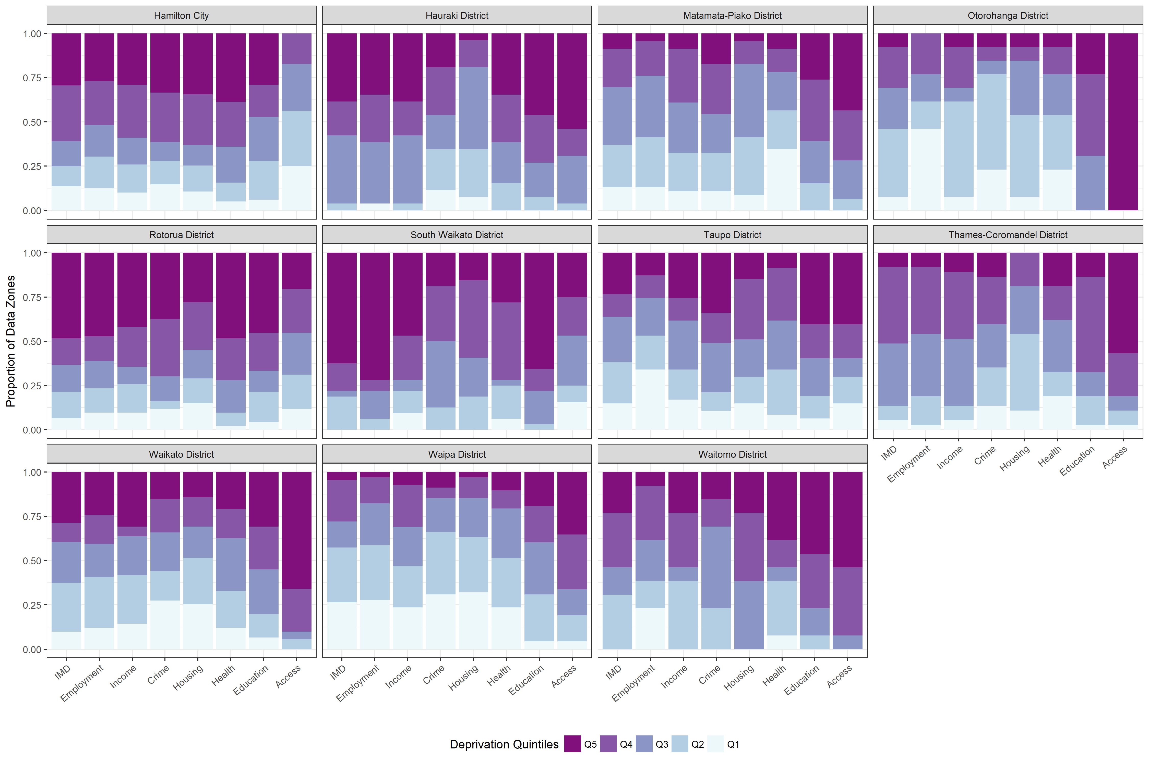
Waikato Councils comparison
Notes:
Comparison of the showing the % of data zones in a TA by deprivation quintile. Each small area in a district has a different mix of each domain that makes up the overall IMD score.
Each district has different reasons for its level of deprivation. Data zones are ranked from lowest to highest deprivation based on their overall IMD score. They are also ranked from lowest to highest deprivation for each specific domain. Each data zone therefore has a different profile of deprivation. For example, a data zone may rank as Q4 for overall IMD but rank as Q5 data zone for employment, Q3 for crime and Q1 for housing. Together these make up the District Profile.
This figure shows the spread of deprivation across the region. It shows that each district is dealing with a different mix of issues. This has policy implications for considering the use of place based policies versus blanket policies to improve social outcomes. How those underlying indicators work together will be very specific to the location and is likely to require a unique approach for each locality.

Slide 11
Employment domain
Percentage of total district population that live in areas that are Q5 for employment - 2013
Notes:
It is useful to compare domains across the Councils to show where there is particular issues to be targeted.
Figure 9 shows the percentage of the total district population that live in high deprivation data zones for the employment domain. The Employment Domain reflects the proportion of working age people who were receiving the Unemployment or Sickness Benefits in 2013.
South Waikato has the most people living in areas with Q5 employment deprivation – 71%. Hauraki follows with 35% and Hamilton at 27%.
Employment deprivation is present in both rural data zones and urban data zones but is much more prevalent in urban areas. Employment deprivation is a strong characteristic of the towns of Huntly, Tokoroa, Waihi, Putaruru, Paeroa, Hamilton, Mangakino, Tirau and Turangi. Employment deprivation is a lesser characteristic of Thames, Raglan, Tuakau, Te Awamutu, Otorohanga, Te Kuiti, and Taupo. Rural areas around Huntly, Meremere, Tapu experience Q5 deprivation.

Slide 12
Income domain
Percentage of total district population that live in areas that are Q5 for income - 2013
Notes:
Figure 10 shows the percentage of the total district population that live in high deprivation data zones for the Income Domain. The Income Domain measures the amount of money per person paid by the government in the form of Working for Families payments and income-tested benefits.
South Waikato has the highest percentage of population living in a Q5 zone for income – 46% followed by Hauraki at 39%. Waikato and Hamilton are 30% and 29% respectively.
All of the following towns are Q5 data zones for income deprivation – Turangi, Mangakino, Ngaruawahia, and Huntly. Most of Tokoroa, Putaruru, Kihikihi, Paeroa, and Waihi are covered by Q5 zones. Parts of Te Kuiti, Otorohanga, Hamilton, Morrinsville, Tuakau, Thames, Taupo, Te Awamutu and Matamata have some Q5 zones.

Slide 13
Health domain
Percentage of total district population that live in areas that are Q5 for health - 2013
Notes:
Figure 11 shows the percentage of the total district population that live in high deprivation data zones for the Health Domain. The Health Domain consists of five indicators: standard mortality ratio, acute hospitalisations related to selected infectious and selected respiratory diseases, emergency admissions to hospital, and people registered as having selected cancers.
The districts with the highest percentage of population living in the highest deprivation for health are Hamilton (38%), Waitomo (36%), and Hauraki (35%).
Health deprivation is a characteristic of both rural and urban zones. There are pockets of Q5 health deprivation in most towns. Urban areas that don’t feature on other deprivation domains are represented here, such as Cambridge, Ohaupo, Te Aroha and rural areas such as Kerepehi. Taupo stands out as only having one Q5 health deprivation data zones which corresponds with the small percentage of the population living in Q5 areas.

Slide 14
Crime domain
Percentage of total district population that live in areas that are Q5 for crime - 2013
Notes:
Figure 14 shows the percentage of the total district population that live in high deprivation data zones for the Crime Domain. The Crime Domain measures victimisations per 1000 people and is largely driven by thefts (55%), burglaries (24%) and assaults (18%)
Overall, but of course you can appreciate that there would be some within-district and between-district variations.
However, data suppression rules mean that we are not able to release those exact numbers for data zones
Spatially high (Q5) rates of crime victimization occurred in large urban areas like Hamilton and in most towns. There was one small rural data zone with Q5 rates of crime victimization south of Te Awamutu and a cluster of data zones south-west of Taupo. Hamilton and Taupo have the highest percentage of their populations living in areas of Q5 crime victimization - 37% and 34% respectively.

Slide 15
Housing domain
Percentage of total district population that live in areas that are Q5 for housing - 2013
Notes:
This figure shows the percentage of the total district population that live in high deprivation data zones for the Housing Domain. The Housing Domain measures the proportion of people living in overcrowded households (60% of the weighting) and rented dwellings (40%) in 2013.
Q5 housing deprivation was less concentrated than overall IMD deprivation. Most areas of housing deprivation are located in urban areas. There are very few rural data zones with Q5 housing deprivation, only Meremere and Wairakei.
Hamilton stands out as the area with the highest percentage of the population living in Q5 deprivation for housing.

Slide 16
Education domain
Percentage of total district population that live in areas that are Q5 for education - 2013
Notes:
This figure shows the percentage of the total district population that live in high deprivation data zones for the Education Domain. The Education Domain measures retention, achievement and transition to education or training for school leavers; as well as the proportion of working age people 15-64 with no formal qualifications; and the proportion of youth aged 15-24 not in education, employment or training (NEET).
The Waikato Region ranks worse than the New Zealand medium for education deprivation. South Waikato has the highest percentage of people living in Q5 data zones for education – 64%. Hauraki follows with 47%, Waitomo at 42% and Taupo at 39%.
Distance and mobility is a feature of education deprivation. However, education deprivation is a characteristic of both rural and urban areas so the issues are not always geographical. All towns have some Q5 data zones.
All of the towns of Turangi, Otorohanga, Paeroa, and Waihi, Putaruru, and Mangakino are Q5 education deprivation zones. Most of Ngaruawahia, Huntly, and Tokoroa is Q5. Some Hamilton, Taupo, Te Kuiti, Te Awamutu, Kihikihi, Cambridge, Thames, Te Aroha, Matamata, Morrinsville, and Tuakau is Q5. Many of the Q5 data zones were located in rural areas in Coromandel, around Putaruru and Meremere, and in a large rural data zone which stretched from Te Ahurei around the Kāwhia Harbour to Owhiro.

Slide 17
Council example
Notes:
It is also useful to look at the domains for each Council area as they can show the combination of factors that are reinforcing deprivation in that area. In this example we can see that employment is the biggest factor along with education which will reinforce each other and impact on income.

Slide 18
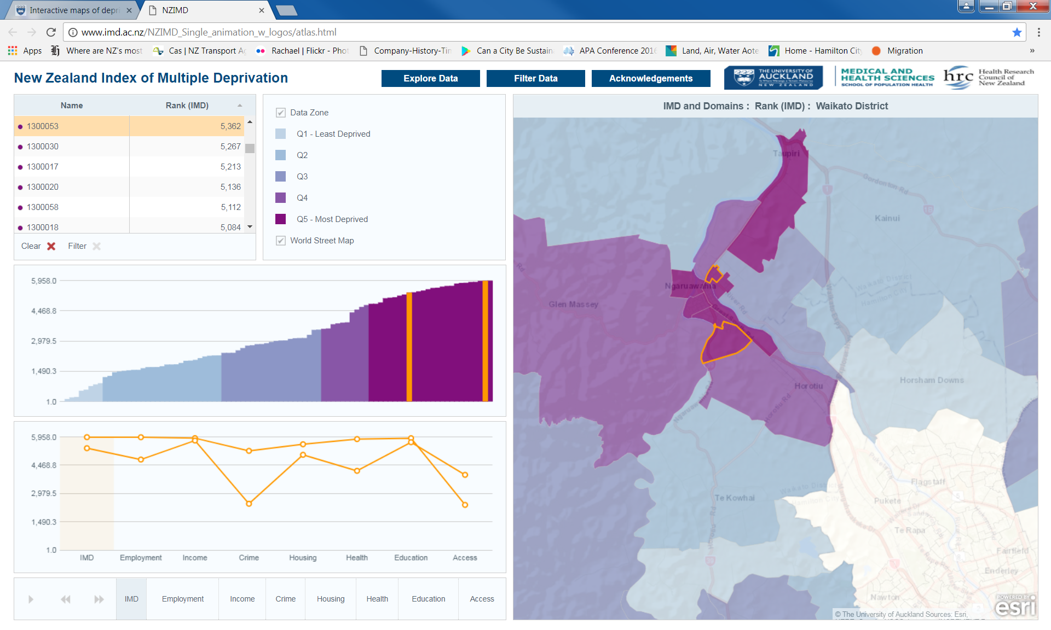

Data zone example
Notes:
Analysing at district level can miss pockets of deprivation at a spatial level. This is an example of the type of information that you can drill down to. For instance in the Waikato District the overall deprivation doesn’t show to be particularly significant. The figures are offset by the very low deprivation around the areas close to Hamilton.
However the Index of Multiple Deprivation allows analysis down to small area level. This is an example of two Q5 data zones in Ngaruawahia. The middle left hand box shows the number of data zones for the Waikato District. The issues in each area are shown in the lower left hand box once selected.
One data zone is ranked at 5,943 out of 5,958 so extremely high for overall IMD. It is high across each domain. The other Q5 zone selected has a different mix of drivers.

Slide 19
Deprivation Report Summary
No two communities are the same
It is simplistic to assess deprivation at a regional level
Each data zone has a different mix of drivers across each district
Policy implications for considering use of place based versus blanket policies to improve social outcomes
Waikato Plan deprivation report to be finalised and sent out with specific council reports from the IMD team

Slide 20
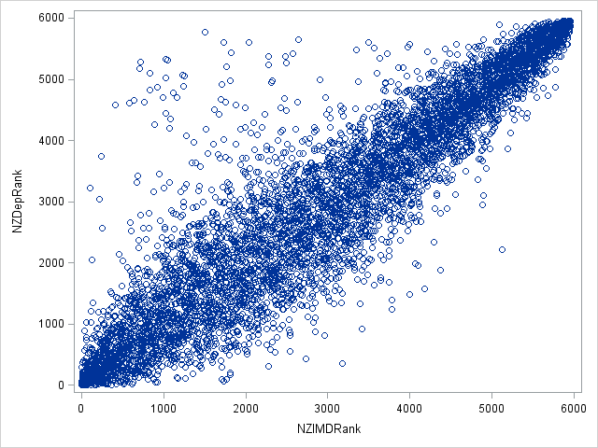
IMD compared to NZDep13
We calculated the population weighted average NZDep13 rank for each data zone
We excluded 86 (1.4%) data zones with MBs without an NZDep13 score
Spearman Correlation Coefficient:
0.92
(p <.0001)
Notes:
Top outliers: There are 78 data zones where the NZDep rank is more than 2000 ranks higher than IMD. Most of these data zones have very high rates of household overcrowding and renting, which carry much more weight in NZDep (a combined weight of 20.9%) compared to the NZIMD Housing Domain (9.3%) and most of these high rates occur in student flatting areas (e.g. in central Dunedin, near Ilam Playing Fields, in Kelburn near Victoria university, in the grounds of Massey University and around Symonds St in Auckland).
Bottom outliers: There are 14 data zones where the IMD rank is more than 2000 ranks higher than NZDep. When we look at the NZIMD’s seven domains in these data zones, we can see that most of these differences are driven by high unemployment and low incomes, which the NZIMD gives more weight to (a combined weight of 56% in the NZIMD versus 35.4% in NZDep). Eight of the 12 data zones have poor health, which NZDep doesn’t count.
This simple analysis represents a good example of how the NZIMD’s seven domains help us to better understand a phenomenon – in this case the domains help explain why the two indices differ.

Slide 21
Acknowledgements & Disclaimer Statement
Access to the data presented was managed by Statistics New Zealand under strict micro-data access protocols and in accordance with the security and confidentiality provisions of the Statistic Act 1975. Our findings are not Official Statistics. The opinions, findings, recommendations, and conclusions expressed are those of the researchers, not Statistics NZ, or the University of Auckland.
This research was funded by the Health Research Council of New Zealand. Thanks to the developers of zone design software for allowing us to use their data, and to the IDI and geospatial teams at Statistics New Zealand for their input and use of data.
The IMD and Data Zones were developed by Daniel Exeter, Jinfeng Zhao, Sue Crengle, Arier Lee and Michael Browne
Census boundaries used in this analysis are Crown Copyright

